Slide 1
COMMUNICATION SKILLS II (ENGL 158) DEPARTMENT OF ENGLISH
COMMUNICATION IN ORGANIZATIONS
NATURE, TYPES AND WAYS TO IMPROVE IT

Slide 2
COMMUNICATION IN ORGANIZATIONS- Keywords
Communication: Is the process of giving and receiving information for an intended purpose.
Organization: Is a group of individuals with a coordinated work/activities for the achievement of a common goal through a hierarchy of authority and responsibility (Adolinama 2005)

Slide 3
COMMUNICATION IN ORGANIZATIONS cont’d
Communication in an organization or organizational communication: This involves the process of information sharing between people in an organization.

Slide 4
ORGANOGRAM/ORGANIZATIONAL CHART
The smooth running of every organization requires a hierarchy of authority and responsibility.
An organogram is a diagram that shows the structure of an organization and the relationships of its parts and positions.
It defines the roles of each individual, the flow of power and the communication routes of the organizations.

Slide 5
The Organization of KNUST
KNUST as an institution/organization is structured on the roles of several officers for its smooth running.
KNUST has enshrined in its University statutes the following officers as the Principal Officers:
1. Chancellor
2. Chairman of the University Council
3. The Vice Chancellor
Other important officers include: The Pro Vice Chancellor and the Registrar.
(Source: https://www.knust.edu.gh/about/administration)

Slide 6
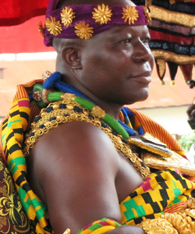
The Organization of KNUST cont’d
Chancellor
Otumfuo Osei Tutu II
Chancellor and Asantehene
(Source: https://www.knust.edu.gh/about/administration)

Slide 7
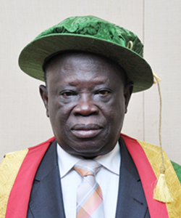
The Organization of KNUST cont’d
University Council
Nana Effah-Apenteng
Chairman of University Council
(Source: https://www.knust.edu.gh/about/administration)

Slide 8
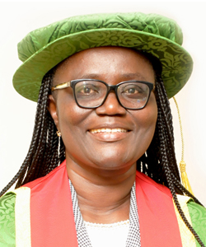
The Organization of KNUST cont’d
Vice-Chancellor
Prof. (Mrs.) Rita Akosua Dickson
(Source: https://www.knust.edu.gh/about/administration)

Slide 9
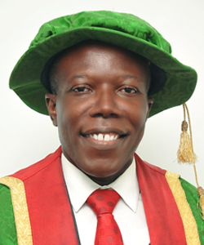
The Organization of KNUST cont’d
Pro Vice-Chancellor
Prof. Ellis Owusu-Dabo
(Source: https://www.knust.edu.gh/about/administration)

Slide 10
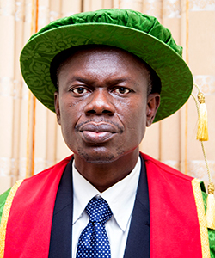
The Organization of KNUST cont’d
Registrar
Mr. Andrews K. Boateng
Registrar/Secretary to University Council
(Source: https://www.knust.edu.gh/about/administration)

Slide 11
The Organization of KNUST cont’d
KNUST resorted to the use of the College System to ensure to the smooth running of academic affairs as the number of students and programmes increased.
The University operates a 3-Tier Academic/Administrative Structure for the College system:
1. Provosts of the Six Colleges
2. Deans of the various Faculties under the Colleges
3. Heads of the various Departments under the Faculties.
(Source: https://www.knust.edu.gh/academics/colleges)

Slide 12
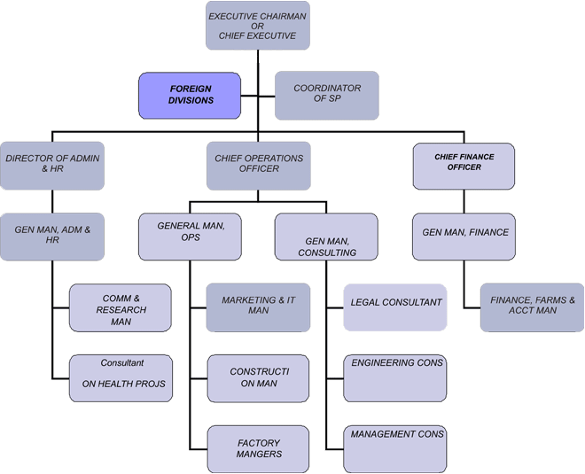
ORGANOGRAM FOR A FIRM

Slide 13
Communication Systems in Organizations/ Types of Organizational Communication
Organizations achieve their set goals because there is constant flow of information vertically (downward and upward), horizontally and even, diagonally.
These information movements can be termed communication systems or routes (Adolinama 2005)

Slide 14
Communication Systems in Organizations/ Types of Organizational Communication cont’d
Vertical Communication
Downward Communication: This is the flow of information from a superior to a subordinate. Eg. Job description, appointment to a committee, dismissal, query etc.
Upward Communication: This is the process of sending information from a subordinate to a superior. Eg. Petition, report on a task, complaints, suggestions etc.

Slide 15
Communication Systems in Organizations/ Types of Organizational Communication cont’d
Horizontal Communication: This is the process of information sharing between individuals at the same hierarchical level of an organization.
Diagonal Communication: This is the sharing of information between individuals of different levels of the organizational hierarchy and in a different section or department.
This type is discouraged in most organizations.
Individuals are encouraged to communicate vertically and horizontally.

Slide 16
Ways to Improve Communication in Organization
Downward Communication:
Establishment of a culture of communication (exchange of pleasantries, brief morning assemblies/prayers, giving briefing, holding meetings, etc.)
Train and coach managers to communicate more effectively using the organization’s house style.
Create opportunities for social interactions in the work place eg. Coffee breaks, monthly/yearly parties, retreats, etc.
Insist on good communication skills as a criterion for recruitment and promotion.

Slide 17
Ways to Improve Communication in Organization
Upward Communication:
Hold regular meetings with representatives of employees. Discuss issues related to workers welfare.
Introduce suggestions box where workers can submit their suggestions, comments and complaints.
Operate an open policy where management is accessible to even the most junior member of staff.

Slide 18
Ways to Improve Communication in Organization
Horizontal Communication:
Institute inter-departmental work teams and task them to hold regular meetings and discuss issues or problems as where and when they crop up.
Rotate jobs to allow each individual manager/officer to experience the job of the other.
Encourage peer counselling as a means of resolving conflicts.
Appoint a communicator as a sort of liaison officer to promote communication between departments by issuing newsletters or bulletins relevant to all departments at appropriate times.

Slide 19
Some Communication Formats in Organizations
Letter Writing
Memorandum (Memo pads etc.)
E-mails
Reports
Minutes
Other technological means (IP Messenger, WhatsApp, Telegram etc.)

Slide 20
Exercise
There is an alleged case of misappropriation of funds by the Managing Director (MD) of J&J Fitness and Wellness Centre. As the Chief Executive Officer (CEO) of the said firm, choose the appropriate communication format to notify the MD to proceed on leave for an investigation to be done.

Slide 21
References
Adolinama, P. P. (2005). Communication Skills for University Students. Accra: ANEST Company Limited
Sekyi-Baidoo, Y. (2003). Learning and communicating (Second Edition). Accra: Infinity Graphics Ltd.

